Slide 1
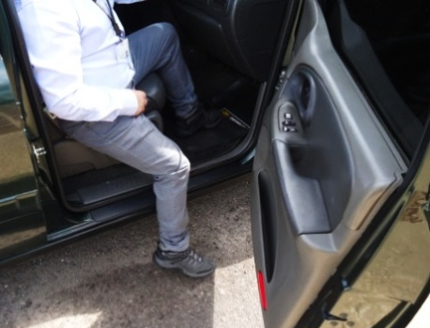
HS&E INCIDENT BULLETIN |  | 2nd half year 2014
Venezuela | Type of incident - Slip/Trip/Fall from same level
Summary:
The employee was getting out of a company SUV at a client site. As he was exiting the vehicle, he stepped onto an uneven sewer cover that was not properly installed, causing his foot to roll and his knee to twist. This resulted in a sprain and hemarthrosis (bleeding into the joint) of the left knee.
Root Causes: | Actions Taken Thus Far: Next Steps
Lack of awareness of hazardous condition. | Enforce Risk Assessment procedure even for low risk activities.

